Slide 1
Team Quadtec
PROJECT ONETAP
Team Details
Anjali Vats :9467221258
Vandana Singh :7021229343
Nikita Soni :9328534394
Arushi Dhiman :7876789761

Slide 2
Description of the Project
Problem Statement
Approach to the Solution
Now a days,companies are selling virtual assistants at a very high price which is not economical for every person.In order to solve this problem we have decided to come up with our own virtual assistant
Our team has decided to build the chatbot using python programming and artificial intelligence
Relevance to the Theme
Techstack Involved
This project is related to open innovation
Python language ,vs code packages used in pysis like pyaudio,pyttx3etc

Slide 3
Details of Technology Stack
PYTHON , VERSION = 3.9.1
Tech1
VS CODE
Tech2
Installed modules like SPEECH RECOGNITION ,PYTTX3 and PYAUDIO
Tech3

Slide 4
Description of the Solution
Step 1
Step 2
Search
We searched for the ideas,problem in depth to create the project
Plan
Then we planned how to solve the issue .
2021
Step 3
Step 4
Engage
After that we started learning python and got familiar with codes and editors
Create
Till now, we have succeeded in programming the pysis to respond and wish we are working more on it

Slide 5
Novelty of the Solution
Our chatbot would provide a real time man machine interface.
It represent optimal man machine communication which is convenient and faster.
It saves a lot of time by automation,can send mails,play music,open different websites on user’s command.
It is designed for purpose to help the user in building a healthy interface and boost productivity.

Slide 6
Growth Plan of the Product
10%
Programming pysis to wish and respond to user’s command.
Checkpoint 1
30%
Then programming it to open commanded websites using webbrowser
Checkpoint 2
45%
Then we have to program it to play music in our device and to tell the current time
Checkpoint 3
75%
Finally most awaited task will be coded in PYSIS which is to send emails on user’s command
Checkpoint 4

Slide 7
Business Aspects of the Hack
01
Market Impact
Our project would draw a very positive impact on market as this will help market to develop fast
Target Consumers
02
Our target consumers are business persons and people who prefer work from home as this will help them to build an integrated environment between them and their devices.
03
Financial Sustainability
The chatbot is easy and does not require much advanced technology to be developed therefore it id economical to use
Product > Project
04
This chatbot wishes,responds,open websites,play music to commands given by user and after some advances it can help the user in sending mails.

Slide 8
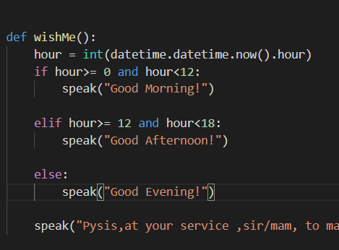
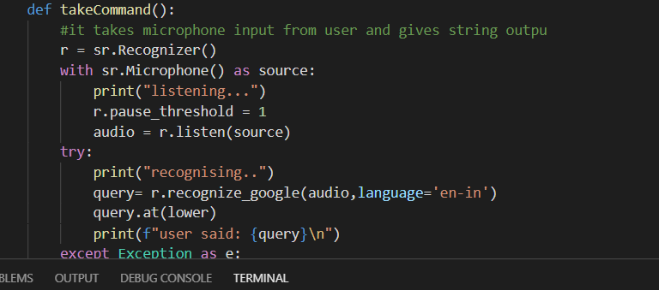
Working Prototype
By defining takecommand function it listens and then responds to our command
Wish me defined using def so that Pysis wishes according to time

Slide 9
Learning Curve
What have you learnt by doing this project?
04
01
Growth 1
TEAMWORK:We learnt how to work and learn together.In the beginning,we were facing many problems but we tackled them together, with a good team those problems were nothing
03
02
Growth 2
02
INSIGHTS OF HACKATHON:This is our first ever hackathon in our life.We got to know about hackathons are conducted and procedure of the same
01
03
Growth 3
COMPUTER CODING:After the team work and insights of hackathons,we learnt our first computer language and started working on our project
04
Growth 4
TIME MANAGEMENT:Together with our studies we managed our time for project,that proved as a great achievement for us as engineers are always indulged in multitasking

Slide 10
About Team
01
02
ANJALI VATS
VANDANA SINGH
Presentator and Project Contributor
Technical Advisor and Project Contributor
03
04
NIKITA SONI
ARUSHI DHIMAN
Technical Researcher and Project Contributor
Technical Researcher and Project Contributor

